Slide 1
CFOC Audit and Reporting Working Group Update
May 2021

Slide 2
Background
CFOC Audit and Reporting Working Group
  Past Projects
    Eliminate Closing Package and Full Financial Statement Audit for 40 Significant Entities
  Current Projects
    Further Leverage Governmentwide Treasury Account Symbol Adjusted Trial Balance System (GTAS) Data (Focused for 40 Significant Entities)
    Streamlining Financial Reporting and Audit for Small Entities (122+ Other Entities)

Slide 3
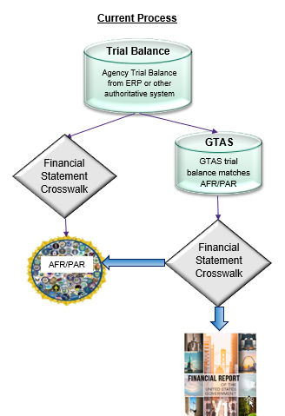
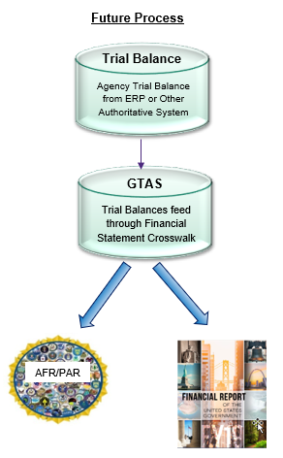
Can We Leverage GTAS for Agency Financial Statements?
Today federal entities produce financial statements from trial balances residing in their core financial systems. Those trial balances are also cross-walked into GTAS trial balances used to produce the Financial Report of the U.S. Government. The result is a bifurcated reporting process. Could these two reporting streams be merged for a more cost-effective, less burdensome, and more consistent approach across the Executive Branch?
Notes:
Currently, federal entities produce financial statements from adjusted trial balances (ATB) residing in the Enterprise Resource Planning or other authoritative system. Those trial balances are also cross-walked into GTAS trial balances used to produce the Financial Report of the United States Government. Therefore, there is a bifurcated reporting process. Could these two reporting streams be merged for a more cost-effective, less burdensome, and more consistent approach across the Executive Branch?

Slide 4
What Would It Take?
Standardize Financial Statements and Footnotes
Obtain appropriate level of detail needed in GTAS for agencies (e.g., level and types of financial statement and footnote breakouts)
Obtain Statement on Standards for Attestation Engagement (SSAE) No. 18 System and Organization Controls (SOC) 1 needed for agencies assurance to rely on the GTAS process as a reporting tool
Implement various reports and drill down capabilities needed in GTAS to make the agency financial statements useful
Notes:
Examples of Bullet #2:
Bureau Level Detail – Having the right level of detail n GTAS to not only produce department level agency financial statements but also the breakout of the data that equates to the bureau level details needed. This is either through the existing TAS if there is a one-to-one relationship or by the agency submitting additional detail in GTAS for bureau breakouts.
USSGL Detail – This example is something new from the DoD meetings that we have started; therefore, we haven’t heard this from multiple agencies although I would expect it is needed by more than just DoD. In order to crosswalk and automate some footnotes, USSGLs might need broken down further.

Slide 5
Can We Streamline Reporting & Audit for Small Entities?
Reporting entity for the Financial Report of the U.S. Government 165 agencies
  24 CFO Act Agencies
  16 Additional Significant Entities
  125 Small Entities
Should the financial reporting and audit requirements of all 165 be the same?
In May 2020 a small agency working group was established to identify options and recommend ways to streamline financial reporting and audit for small agencies
Over 99% of Assets, Liabilities, Revenue, Expenses

Slide 6
What Are Some Options?
Recommendation from working group
  Short-term – Exempt small agencies from financial reporting requirements that are only needed for Financial Report
  Mid-term – Eliminate or streamline MD&A for small agencies (FASAB change)
  Long-term – Explore/pilot consolidating small agencies financial statements and audits (legislation change)
Next Steps
  Socialize with all 165 agencies in the Financial Report
  Set up working group to develop a plan for the long-term recommendation
Notes:
Long-term - This may be pursued in conjunction with small agency use of shared services and in a phased/incremental fashion.

