Slide 1
Welcome to IGT Day!
Keith Jarboe
April 17, 2018

Slide 2
Governmentwide Intragovernmental Update
Jaime Saling
April 17, 2018

Slide 3
Agenda
  IGT Material Weakness
  IGT Accomplishments
  Sub-Category Statistics
  IGT Elimination Effort and You!
  Future Plans
  Final Thoughts
  Questions

Slide 4



IGT Material Weakness
History of Material Weakness for the U.S. Government
As it has for each of the past 21 fiscal years, the U.S. Government Accountability Office (GAO) issued a disclaimer of opinion on the FY 2017 Financial Report of the U.S. Government. In its report, GAO cited the government's difficulty to "adequately account for and reconcile intragovernmental activity and balances between federal entities" as a material weakness and a major impediment to expressing an opinion.
Three Primary Impediments
DoD
Compilation
IGT
Disclaimer

Slide 5
IGT Material Weakness
The Issue
The Simplicity of the IGT Issue:
“If two federal entities engaged in an intragovernmental transaction do not both record the same intragovernmental transaction in the same year and for the same amount, the intragovernmental transactions will not be in agreement, resulting in errors in the consolidated financial statements.”
- FY 2017 U.S. GOVERNMENT ACCOUNTABILITY OFFICE INDEPENDENT AUDITOR’S REPORT

Slide 6

The Issue
IGT Data Quality

Slide 7
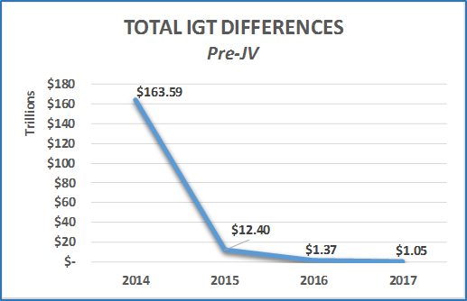
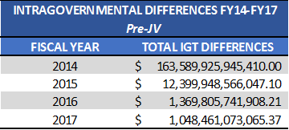

Completing the IGT Model
IGT Accomplishments – Trend Analysis
Pre-JV Differences between FY16 and FY17 reduced by 23% or $321Billion.

Slide 8
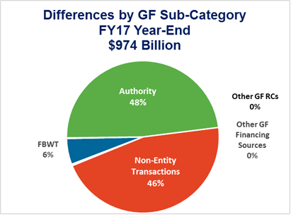
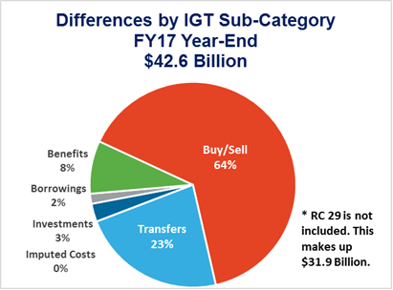
Sub-Category Statistics
Total IGT Differences– FY2018
Notes:
We have volume – have it in talking points or for questions.

Slide 9
Top Sub-Category Statistics
General Fund Activities
General Fund of the U.S. Government
    Fund Balance with Treasury, Authority, Non-entity Transactions, etc.
    $974 Billion out of the $1,048 Billion
Notes:
We have volume – have it in talking points or for questions.

Slide 10
Top Sub-Category
General Fund Activities
Responsible for recording and reporting the assets and liabilities associated with financing government operations
Required to complete the government’s accounting model, and provide balanced governmentwide financial statements
Undergo its inaugural audit on fiscal year 2018 financial reporting
Majority of Differences are the absence of complete IRS Reporting (86.98%) with the General Fund
  Incomplete reporting by IRS for Custodial Activities:
    Tax Receipts associated with General Fund Receipt Accounts
    Warrants received for Refund Collection & Interest and the Payment(s) for Refund Collection & Interest
  Collaborative working group with Treasury’s DCFO office, IRS, and Fiscal Service to implement short-term solution for 2018 and long-term solution for 2020

Slide 11
2nd Largest Sub-Category Statistics
Buy/Sell Activities
Buy/Sell Transactions
    Buy/Sell activities are transactions between agencies managed through an interagency agreement, often called a reimbursable agreement.
    G-Invoicing
    $27 Billion out of the remaining $43 Billion
    4,250 differences out of 5,078 total IGT volume
Notes:
We have volume – have it in talking points or for questions.

Slide 12
Sub-Category Statistics
Transfers Activities
Transfer activities are non-exchange transactions that move budgetary and/or proprietary resources between two or more TAS. To execute a Transfer means to reduce resources (budgetary and/or proprietary) in one TAS and increase them in one or more other TAS the total cumulative amount.
Transfers Logic Module (TLM)

Slide 13
Sub-Category Statistics
Fiduciary Activities
Fiduciary Transactions are Intragovernmental transactions that consist of Fiscal Service Investments and Borrowings; Federal Financing Bank (FFB) borrowings; Department of Labor (DOL) Federal Employees’ Compensation Act (FECA) transactions; and Office of Personnel Management (OPM) employee Benefit transactions.
Quarterly Authoritative Source files available to agencies:
  Investments: in GTAS
  Borrowings: in GTAS
  Benefits (DOL): on the Fiscal Service website
  Benefits (OPM): on the Fiscal Service website
Notes:
Of the Other IGT Differences, Buy/Sell makes up 75% of the total.

Slide 14
IGT Elimination Effort and You!
Accurate reporting of balances and proper elimination of activity depends largely upon….
COMMUNICATION

Slide 15
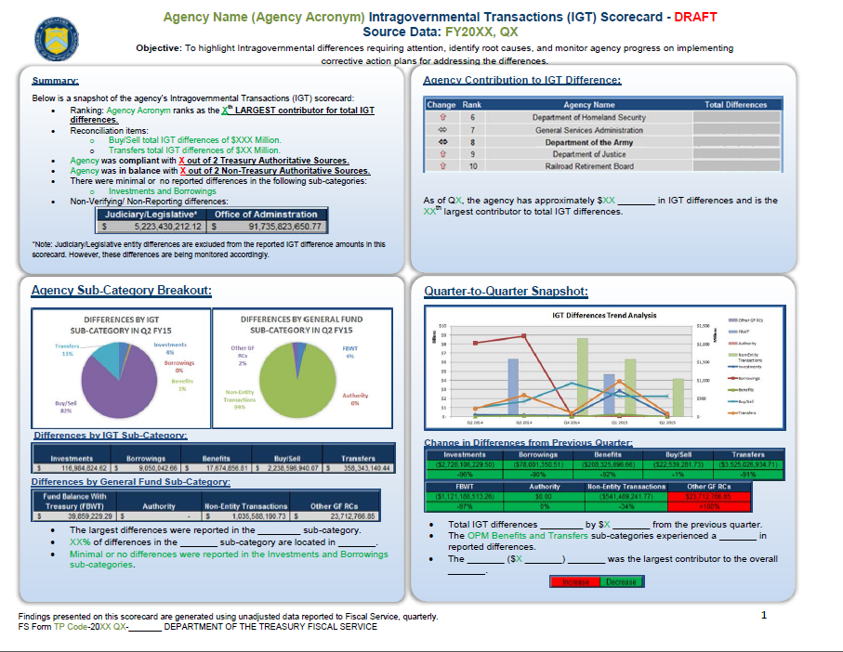

Slide 16

IGT Elimination Effort and You!
The resolution of Intragovernmental differences will occur as a result of:
  Education
  Preparation
  Collaboration
  Implementation

Slide 17
Future Plans
Continue the following initiatives:
  Intragovernmental Scorecard Program
  Monitor the Root Cause Analysis and Corrective Action Plan documentation provided by the agencies
  Material Difference Reporting and Certification
Evaluate the usage of “non-reciprocating” USSGL accounts
Enhance TFM 2-4700 guidance (Appendix 10) on Intragovernmental Business Rules
Improve or develop USSGL guidance impacting IGT
Treasury/IRS/Fiscal Service Collaboration Group
Support the G-Invoicing Initiative aimed at improving communication and reducing differences in the Buy/Sell Sub-Category

Slide 18
Final Thoughts
Remediating the Material Weakness
Ultimate goal is to eliminate IGT differences at the governmentwide level for the Consolidated FR.
“Resolving the intragovernmental transactions problem remains a difficult challenge and will require a strong and sustained commitment by federal entities to timely resolve differences with their trading partners, as well as continued strong leadership by Treasury and OMB.”
- FY 2017 U.S. GOVERNMENT ACCOUNTABILITY OFFICE INDEPENDENT AUDITOR’S REPORT
Notes:
“…as well as continued strong leadership by Treasury and OMB.”
As you can see, we are tasked with leading the charge to reduce the governmentwide IGT differences, and this is something we take very seriously. Please keep this in mind when we contact your agency for more information about a difference, develop guidance in the TFM for agencies to follow, or roll out a new requirement for documenting or reconciling with your trading partners…we have a job to do, and it takes each and every agency to help us be successful.

Slide 19

Contact Information
Jaime Saling
Director
Fiscal Accounting
Bureau of the Fiscal Service
(304) 480-5129
Jaime.Saling@fiscal.treasury.gov
Intragovernmental Questions:
GovernmentwideIGT@fiscal.treasury.gov

Slide 20
G-Invoicing
Program Update
IGT Day
April 17, 2018
Speaker: Keith Jarboe
Fiscal Service

Slide 21
How Long Will Keith Talk Today?
Program Background and Update
Implementation Roadmap
Release 2.1 – General Terms & Conditions
Process and Data Flow Architecture
Implementation and Onboarding
The Remainder of Our Day Together

Slide 22
Executive Summary
Initiative Overview
Government Invoicing (G-Invoicing) is the long-term sustainable solution to improve the quality of Intragovernmental Transactions (IGT) - Buy/Sell data in support of more accurate financial management by Federal Trading Partners
G-Invoicing will address current Buy/Sell accounting and reporting challenges by:
  Providing common platform for brokering all IGT Buy/Sell activity
  Implementing a Federal IGT Buy/Sell Data Standard and providing transparent access to a common data repository of brokered transactions
Targeted Stakeholders
All Federal Program Agencies and Federal Financial Enterprise Resource Planning (ERP) System Providers engaged in the execution or program support of the IGT Buy/Sell transaction lifecycle
  2017 Buy/Sell volume consisted of 1.2 Million transactions with a total value of approximately $742 Billion

Slide 23
Program Status
System Development
  Release 2.1 – General Terms & Conditions
    Deploying in March 2018 and will Permit Governmentwide use of G-Invoicing to broker GT&Cs
  Release 2.2 – Orders – Design/Develop Iterations beginning in March
Federal Intragovernmental Data Standard (FIDS)
  Incrementally defining and publishing in the Fiscal Service Data Registry
  Collaborating with the Financial Management Standards Committee (FMSC), DATA Act PMO, and Intragovernmental Transactions Working Group (ITWG)
Outreach Efforts Underway
Broad-based exposure through Authoritative Organizations and related Colloquiums
  AGA, ASMC, JFMIP, OFIT(FMSC), OSSPI (formerly USSM)
Individual Stakeholder-based Focus Groups (Agency and ERP Vendor levels)
Socializing G-Invoicing Process and Data Flow Architecture to provide panoramic landscape of Stakeholder system and personnel integration points

Slide 24
Implementation Roadmap
As of April 2018
Complete
Delay
On Track
At Risk
Today
FY 2017 (Oct 16 – Sep 17)
FY 2018 (Oct 17 – Sep 18)
FY 2019 (Oct 18 – Sep 19)
FY 2020 (Oct 19 – Sep 20)
TFM Bulletin
Dec 2016
“What’s on the Horizon”
CFO Memo and TFM Update
Spring 2017
GT&C Interface Specs Final
Jun 2017
Order Interface Spec Final
April 2018
Performance & Invoice Interface Spec Final
Jan 2019
CFO Memo and TFM Update
Spring 2019
CFO Memo and TFM Update
Spring 2020
CFO Memo and TFM Update
Spring 2018
Release 2.0.1
Patch
Aug 2017
Release 2.2
Orders
Feb 2019
Release 2.3
IPAC Release 18.3
Performance/Invoices
Aug 2019
Release 1.0
Go Live
Sep 2016
Release 2.0
Complete
Jul 2017
Release 2.1
GT&C
Mar 2018

Slide 25
We’re Open For Business…
Release 2.1 Deployed on 3/24/2018
  Governmentwide capability to broker General Terms & Conditions
Enhancements Include:
  Second Approver level for Buyer and Seller
  Draft status for internal processing of GT&C prior to sharing with Trading Partner
  Optional Dollar Value enabling more broad-based Agreements
Come in
WE’RE
OPEN
Reporting Capabilities:
  Outbound GT&C data interface for consumption by Agency financial reporting systems through web services
  User Identity Report in support of Agency Administrators managing end-user roles and data access permissions

Slide 26
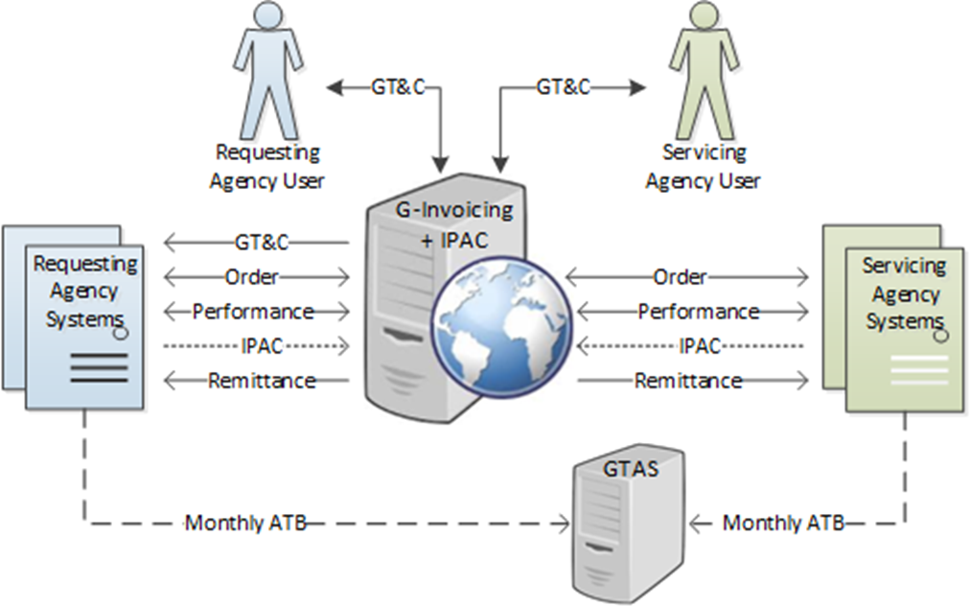
IGT Process & Data Flow Architecture
Convey a summary of the information Trading Partners will be required to broker and outline methods of interacting with G-Invoicing to exchange data
Serve as a blueprint for engaging Agency and ERP stakeholders in discussions to define G-Invoicing implementation approaches and timelines
Intended to be an encompassing look at the architecture, underlying functions, and integration points where end users and/or their respective financial systems can exchange data with Fiscal Service Systems

Slide 27

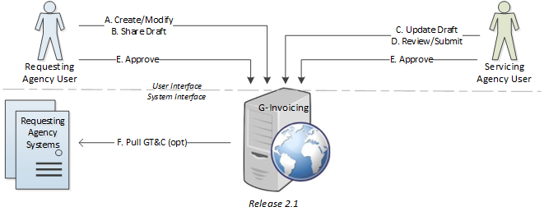
General Terms and Conditions
Summary of Mandatory Data Elements by Category (33 elements required)
GT&C Identifier (3)
Requesting Agency Identifier (2)
Servicing Agency Identifier (2)
Shared Agreement Terms (7)
Preparer and Approver Identifiers (19)
(40 other data elements are opt/derived)
Requesting or Servicing Agency may initiate GT&C
GT&C agreements are created and approved through a user interface in G-Invoicing
Full automation is available beyond the GT&C agreement
  Agencies choose which systems they prefer to integrate
Attachments are optional and available for either partner to view or pull
Requesting Agency must reference approved GT&C when creating Order (on next slide)
  This can be pulled into Agency system (Pull GT&C, shown here)
  Or user can copy/paste (not shown)

Slide 28
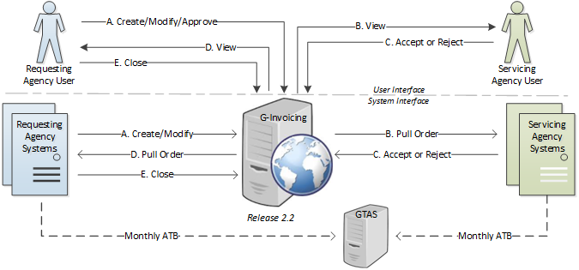
Orders
If an Agency desires full automation with their current systems, the following functions must be supported:
  Push an Order to G-Invoicing, covering new, approved, rejected, modified or closed Orders
  Pull a list of Order changes and a specific Order from G-Inv.
G-Invoicing will contain data to support ATB entries, but will not replace GTAS reporting
Summary of Mandatory Data Elements by Category (79 elements required)
GT&C and Order Identifiers (3)
General Order Information (16)
Requesting Agency Order Details (22)
Servicing Agency Order Details (10)
Preparer, Contact and Approver IDs (28)
(128 other data elements are opt/derived)

Slide 29
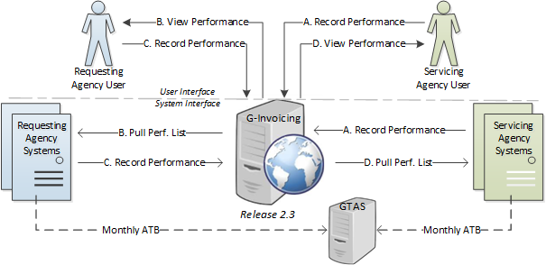
Performance
Mandatory Data Elements by Category (9 elements required)
Transaction Identifiers (3)
Performance Information (6)
(3 other data elements derived)
If an Agency desires full automation with their current systems, the following functions will need to be supported:
  Push a Performance transaction to G-Invoicing, for any new or modified records
  Pull a list of Performance changes from G-Invoicing
Types of Performance are based on EDI 856 standards
  Servicing Agency: 011-Shipped, 017-Estimated Delivery, 035-Delivered
  Requesting Agency: 050-Received, 201-Acceptance

Slide 30
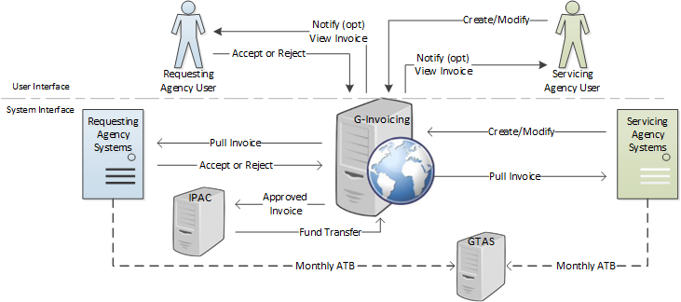
Invoices – Original Plans
Multiple advances process not shown
Emphasis on Invoice approval prior to fund transfer
Reliance on, and relationship with, Performance information not yet complete defined
Adjustment process not shown
Mandatory Data Elements (24)
Servicing Agency Invoice (11)
Servicing Agency Line (9)
Requesting Agency Approval (4)

Slide 31
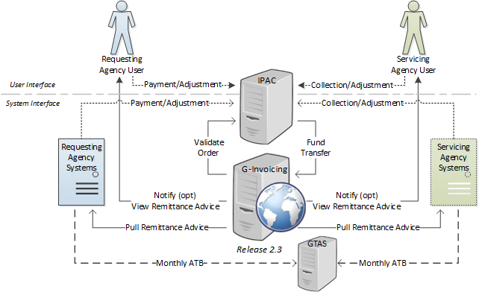

Invoices – New Plans
    Payments, Collections, Advances and Adjustments continue to flow through IPAC
    Most IPAC transactions will reference Orders in G-Invoicing
Additional IPAC Mandatory Data Elements (4)
Order Identifiers (3) … i.e., order, line & schedule
Capitalization Indicator (1)

Slide 32
Invoices – Impact on Agencies
Servicing Agencies do not need to provide Invoices to G-Invoicing
  Continue existing interface with IPAC but include references to G-Invoicing Order
  This may be more granular than your IPAC transactions are today
Requesting Agencies do not need to implement Invoice approval process
  Future Vision - Controls governing payment/collection will be negotiated on each Order
    As negotiated, exchange of Performance data may be needed prior to transfer of funds
No concern over delayed Invoice approval holding up payments
Eases Onboarding
  Fewer changes to Agency Systems and ERP Vendor Offerings
    Agencies are already interfacing 80% of required Invoice data with IPAC
  Duplicate transactions less likely during Agency onboarding period
  Adjustments and Advances go through IPAC as they do today
Disadvantages
  Removes Invoice workflow
  Assumption that Agencies can leverage existing interface to IPAC

Slide 33
Agency Implementation
Governmentwide Roll-out of G-Invoicing has begun
  Actively Enrolling, Training, and Supporting Production Users
Onboarding and Implementation Resources
  Each Agency will be assigned an Agency Implementation Team (AIT) Lead from FRB St. Louis
Focus Groups and Working Sessions - Ongoing
Playbook and Implementation Guide
Office Hours
Training
  Conducted at our FRB St. Louis AIT office in Crystal City, Virginia
  On-line training via webinars

Slide 34
Implementation and Onboarding Challenges
Agencies may be slow to adopt G-Invoicing
  Leveraging ITWG and working sessions to capture requirements and concerns early
  G-Invoicing Implementation Playbook to assist Agencies with onboarding process
  Incremental on-boarding based on transaction lifecycle
    Allows Agencies time to adapt business processes and perform system upgrades
    Establishing implementation dates for each transaction life cycle step would allow Agencies time to incorporate system changes/upgrades
ERP Vendors may be slow to implement changes needed to support on-boarding schedules of their Agency customers
  Providing interface specifications in advance of release that supports exchange
  Leveraging the Financial Management Standards Committee (FMSC) to aggregate Agency needs related to G-Invoicing
  Establishing mandated implementation dates for each transaction lifecycle step to assist vendors in aligning updates to their offerings to our development roadmap

Slide 35
What’s on Deck Today…
IGT Collaborative Working Group Discussion
  Update on activities as well as onboarding efforts from key Stakeholders
Lunch
  Most vocal audience member during my presentation is buying for everyone
Federal Intragovernmental Data Standard update
  An update on our data standardization activities
Onboarding Discussion
  G-Invoicing is open for business – how to get involved
Agreement Brokering Discussion and Demo
  Yes G-Invoicing does actually exist – and you’ll get to see it in action
A look ahead to what the G-Invoicing Program will be up to this year
  System Development, ITWG, Outreach, and Customer Engagement
IGT Automation
  Discussion on interfacing your ERP with G-Invoicing

Slide 36
Collaborative IGT Working Groups
IGT Day
April 17, 2018

Slide 37
A Collection of Voices
Intragovernmental Transactions Working Group
  Led by the G-Invoicing Program, this working group is leveraged to assist in defining Federal Intragovernmental Data Standards (FIDS) and related functionality implemented through G-Invoicing solution
  Join the ITWG Focus Group by sending an email to IGT@Fiscal.Treasury.gov
Financial Management Standards Committee
  A collaborative forum to discuss Financial Management needs, to share best-practices, and to weigh in on changes to policy
  It functions as the Financial Management Community’s platform to discuss and develop standardized solutions that promote financial integrity and operational efficiency across government
  https://www.fiscal.treasury.gov/fsservices/gov/fit/fit_fmsc.htm
Agency Level Working Groups

Slide 39


Government / CGI Collaboration
FMSC Momentum Working Group
Strategic Priorities
Agency-Funded Enhancements with Baseline Value
CGI Federal Momentum Product Planning and Development
Tactical Enhancements
Momentum User Group
Priority Fixes
Best Practices
Ideas Day and Agency Votes
Momentum Baseline Functionality

Slide 40
FMSC Sub-Working Group Chairs
  Debbie Daniell
    Director – Agency Reporting and Analysis Division
    Department of the Treasury – Fiscal Service
    Oracle Sub-Working Group Lead
  Reed Waller
    Assistant Director, Financial Management Initiatives Group
    U.S. Department of Justice - Finance Staff, Justice Management Division
    CGI-Momentum Sub-Working Group Lead

