Slide 1
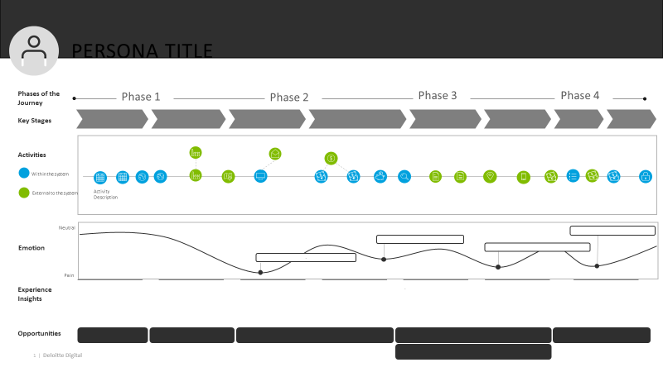
Journey Map Job Aid
The DEEE journey map template is intended to help visualize and document the full scope of the analyzed process from a user’s perspective (called a “persona”) by capturing observations, pain points, and needs
Phases and Key Stages of the Journey
High level sections of a journey that anchor the end-to-end processes and helps to align different journeys that are a part of the same process.
Activities
The step-by-step course a persona takes within each stage.
Emotion Path
Description of the level of intensity of an activity as experienced by the persona. These are usually the result of pain points.
Experience Insights
Added insight into the persona experience at each point on the journey. These can be positive, negative, neutral additional context.
Opportunity
Possible solutions that could alleviate identified challenges for relevant users.
Direct Quote
Representative quote that exemplifies persona sentiment at that stage.
Notes:
Ingrid
-Example journey map job aid
-Blends HCD with traditional process analysis to visualize findings
-Activities can be documented from traditional analysis, tying in user first hand emotions and perspective
-Layers information from users within different roles to visualize one streamlined process
-Would this template be helpful?

Slide 2
Persona title
Phases of the Journey
Phase 1
Phase 2
Phase 3
Phase 4
Key Stages
Activities
Within the system
External to the system
Activity Description
Neutral
Emotion
.
Pain
Experience
Insights
.
Opportunities
Notes:
Presenter – Ryan J.

Slide 3
SAMPLE
Agency Accountant
FIT Use Case Alignment
The Bill to Collect (B2C) journey of Agency Accountants, and Accounting Technicians
Use Case: Penalties, Interest, & Collections
Business Actors: Customer Accountant & Accounting Technician
Key Stages
Establish Payer
Create Receivable
Assess Charges
Adjust Charges
Process Collections
Report
Activities
Monthly Receivable Progression spreadsheet reviewed
AR invoice & receipt template sent to Provider
Collection processed via Oracle for associated receivable
Quarterly TROR prepared, and sent to Agency for Approval
Quarterly TROR submission to DMIS
Identify need for new customer or modification to existing customer
Payer profile template sent to ARservicedesk mailbox
Agency bills non-federal entity
Receive supporting accounts receivable documentation from Program Office
AR invoice created in Oracle
Employee administrative debt past 31 days sent to Provider for salary offset approval
Delinquent debt referred to DMS day 90-121
AR Invoice adjusted per agency request
Payment received via mail-in check
Customer Agency
Customer 1 Specific
Customer 2 Specific
Gather customer information to populate payer profile template
Payer profile created in Oracle
Receivable created and tracked internally, sent to Provider upon receipt of collection
Populate AR invoice template and send to Provider
Non-Administrative Delinquent debt past 31 days referred to AMAD
Salary offset approved and processed
Delinquent debt tracked, and monitored internally
Receivable adjustment identified, and request sent to Provider
Payment received via Pay.gov
Deposit confirmed and verified via Collections Information Repository report
Check and cash receipt template sent to Provider for processing
Franchise log updated to reflect paid status of receivable
Final TROR approval
Provider
Positive
Emotion
Excel based AR Request templates are occasionally completed incorrectly due to hidden fields resulting in input error
In order to reduce potential rework if there is an error or adjustment needed, we send invoice and receipt templates at the same time upon receipt of collection
Neutral
It would be great if we had one report from Provider to track our receivables and associated collections in real time
Negative
Experience
Takeaways
The Agency Accountant collects payer information for non-federal customers from their program offices. A payer profile template is then manually populated and sent to Provider to establish or edit a customer payer profile within Oracle.
The Agency Accountant manually populates the AR invoice template using billing information collected from their program offices. Templates can be cumbersome and are susceptible to human error. In some instances, invoice templates are not completed until receipt of collection is received in order to reduce potential rework.
The Agency Accountant tracks and monitors the majority of debts manually within internal databases and often retains debts past the standard referral to DMS following 121 days delinquency. The small remainder of delinquent debts and repayment agreements are referred to Provider for aging.
The Agency Accountant reviews the monthly progression spreadsheet sent by Provider to identify any potential adjustments needed. If a necessary adjustment to an invoice is identified, an AR Invoice template is populated and sent to Provider noting the requested adjustment.
Collections must be processed by Provider before Agency Accountant’s are able to view updated balances within Oracle. At month end, this can slow down reconciliations and Agencies preferred being able to view and update their balance data in real time.
Provider Accountants compile agency receivables data quarterly to develop TROR report and send to Agency for Approval. Agency Accountants submit final approval, and Provider submits TROR to Treasury Debt Management Information System DMIS.
Smart Workflow enablement to prioritize and alert Provider of unprocessed collections when approaching period-end (e.g., monthly, quarterly) and automatically notify Agency upon successful posting to Oracle
Opportunities
Web-based AR request template with data validation, allowing users to submit request templates after they have input all required information
Smart Workflow Enablement solution (i.e., ServiceNow or Salesforce) that syncs Oracle receivables and collections data in one shared location
Notes:
Ingrid

